Slide 1
Minimizing DDOS Attack by Applying Clustering Scheme in VANET
Md.Tanvir Hossain
19303038

Slide 2
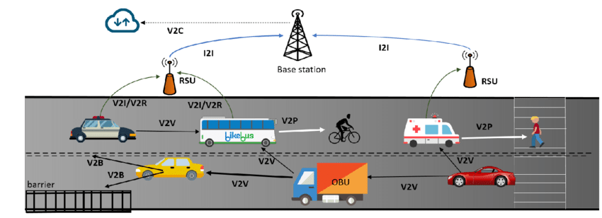
Vehicular Ad-Hoc Network

Slide 3
Literature Review
AUTHORS | Techniques used (parameters) | Outcome
Lynda Mokdad et al. | DJVAN: Detecting jamming attacks in Vehicle Ad hoc Network | Detected jamming attacks in VANETs by the use of PDR (packet delivery ratio) and with performance analysis detected a threshold level that helps in differentiating between a poor link and an attacker.
Karan Verma et al. | IP-CHOCK | Nodes with the same IP addresses in the database will be treated as attackers.
Hemanth Kumar .P et al. | Used a Transfer Scheduler scheme along with Prototype analyzer | Distinguished the real authentic transfer with that of attack transfer and scheduled the transfer for better bandwidth usage.
S.Roselin Mary et al. | APDA: Attacked Packet Detection Algorithm | Detected DoS attacks before verification time which reduces the overhead delay for processing therefore enhancing the security.
Usha Devi Gandhi and R.V.S.M Keerthana | RRDA: Request Response Detection Algorithm | Detected DoS attack after APDA using RRDA which increases the response time (work is done on multiple requests)

Slide 4
Reference
https://www.sciencedirect.com/science/article/abs/pii/S0166531615000048

Slide 5
Questions
Why you Chose this subject
Is it use in real world
How you gonna implement this

